Slide 1

Turing Machines
Sections 17.6 – 17.7

Slide 2
The Universal Turing Machine
Universal Turing Machine:
A programmable TM that accepts as input:
program input string
It executes the program, and produces the output:
output string

Slide 3
The Universal Turing Machine
To formally define the Universal Turing Machine U we need to:
1. Define an encoding operation for TMs.
2. Describe the operation of U given input <M, w>, the
encoding of:
  ● a TM M, and
  ● an input string w.

Slide 4
Encoding a Turing Machine M
We need to describe M = (K, Σ, Γ, δ, s, H) as a string:
  The states
  The tape alphabet
  The transitions

Slide 5
Encoding the States
Let i be ⎡log₂(|K|)⎤.
Number the states from 0 to |K|-1 in binary:
  ⋅ Number s, the start state, 0.
  ⋅ Number the others in any order.
If t′ is the binary number assigned to state t, then:
  ⋅ If t is the halting state y, assign it the string yt′.
  ⋅ If t is the halting state n, assign it the string nt′.
  ⋅ If t is any other state, assign it the string qt′.

Slide 6
Example of Encoding the States
Suppose M has 9 states.
i = 4
s = q0000,
Remaining states (where y is 3 and n is 4):
  q0001, q0010, y0011, n0100,
  q0101, q0110, q0111, q1000

Slide 7
Encoding a Turing Machine M (cont’d)
The tape alphabet:
ax : x ∈ {0, 1}⁺,
|x| = j, and
j is the smallest integer such that 2^{j} ≥ |Γ|.
Example: Σ = {, a, b, c}. j = 2.
❑ = a00
a = a01
b = a10
c = a11

Slide 8
Encoding a Turing Machine M (cont’d)
The transitions: (state, input, state, output, move)
Example: (q000,a000,q110,a000,→)

Slide 9
An Encoding Example
Consider M = ({s, q, h}, {a, b, c}, {, a, b, c}, δ, s, {h}):
<M> = (q00,a00,q01,a00,→), (q00,a01,q00,a10,→),
(q00,a10,q01,a01,←), (q00,a11,q01,a10,←),
(q01,a00,q00,a01,→), (q01,a01,q01,a10,→),
(q01,a10,q01,a11,←), (q01,a11,h11,a01,←)
state | symbol | δ
s | ❑ | (q,, →)
s | a | (s,b,→)
s | b | (q,a, ←)
s | c | (q,b, ←)
q | ❑ | (s,a, →)
q | a | (q,b,→)
q | b | (q,b, ←)
q | c | (h,a, ←)
state/symbol | representation
s | q00
q | q01
h | h10
❑ | a00
a | a01
b | a10
c | a11

Slide 10
Enumerating Turing Machines
Theorem: There exists an infinite lexicographic enumeration of:
(a) All syntactically valid TMs.
(b) All syntactically valid TMs with specific input alphabet Σ.
(c) All syntactically valid TMs with specific input alphabet Σ and specific tape alphabet Γ.

Slide 11
Enumerating Turing Machines
Proof: Fix Σ = {(, ), a, q, y, n, 0, 1, comma, →, ←}, ordered as listed. Then:
1. Lexicographically enumerate the strings in Σ*.
2. As each string s is generated, check to see whether
it is a syntactically valid Turing machine description.
If it is, output it.
To restrict the enumeration to symbols in sets Σ and Γ, check, in step 2, that only alphabets of the appropriate sizes are allowed.
We can now talk about the i^{th} Turing machine.

Slide 12
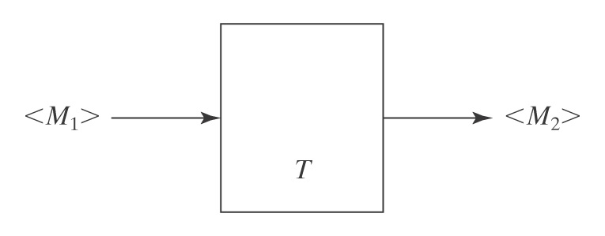
Another Win of Encoding
One big win of defining a way to encode any Turing machine M:
● We can talk about operations on programs (TMs).

Slide 13
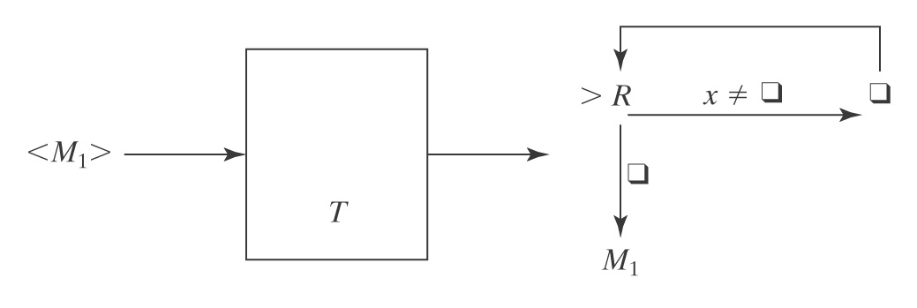
Example of a Transforming TM T:
Input: a TM M₁ that reads its input tape and performs some operation P on it.
Output: a TM M₂ that performs P on an empty input tape.

Slide 14
Encoding Multiple Inputs
Let:
<x₁, x₂, …x_{n}>
mean a single string that encodes the sequence of individual values:
x₁, x₂, …x_{n}.

Slide 15
The Specification of the Universal TM
On input <M, w>, U must:
● Halt iff M halts on w.
● If M is a deciding or semideciding machine, then:
  ● If M accepts, accept.
  ● If M rejects, reject.
● If M computes a function, then U(<M, w>) must equal M(w).

Slide 16
How U Works
U will use 3 tapes:
● Tape 1: M’s tape.
● Tape 2: <M>, the “program” that U is running.
● Tape 3: M’s state.

Slide 17
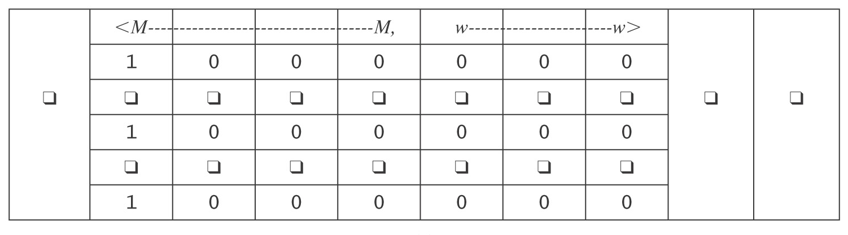
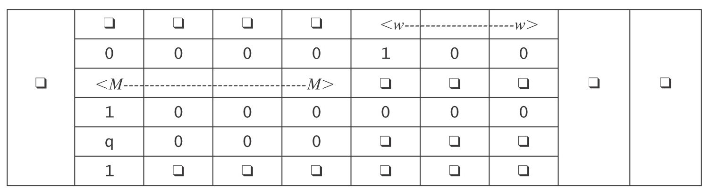
The Universal TM
Initialization of U:
1. Copy <M> onto tape 2.
2. Look at <M>, figure out what i is, and write the encoding of state
s on tape 3.
After initialization:

Slide 18
The Operation of U
Simulate the steps of M :
1. Until M would halt do:
  1.1 Scan tape 2 for a quintuple that matches the
  (current state, input) pair.
  1.2 Perform the associated action, by changing tapes 1 and 3. If
  necessary, extend the tape.
  1.3 If no matching quintuple found, halt. Else loop.
2. Report the same result M would report.

